Slide 1


ADOL KOPI
Dony Iskandar
ABT 5A
Web Design

Slide 2



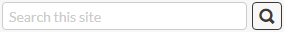




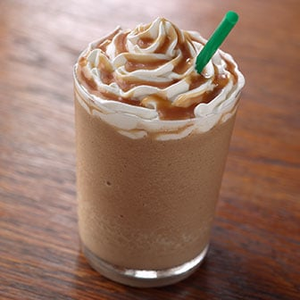


ADOL KOPI

Slide 3


ADOL KOPI

Slide 4

ADOL KOPI

Slide 5


ADOL KOPI

Slide 6
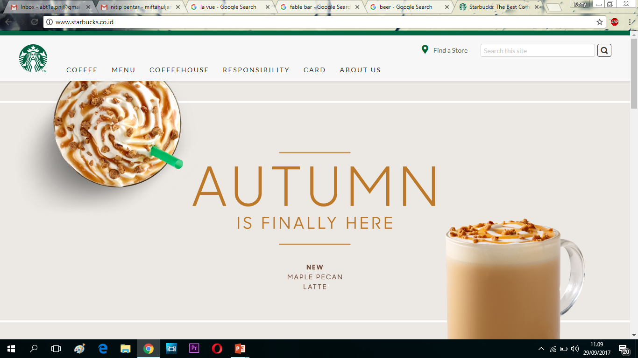
REFERENSI

Slide 7
LAY OUT
LOGO
Find Store
SEARCH
NAVIGATION
CONTENT
P
R
O
D
U
C
T
HEADER

